Slide 1
B.T.P
Topic :-Stock Price Prediction(Nifty50)
Time Series Forecasting Modelling
PRESENTED BY: Group14
ALAVYA SINGH (CSJMA20001390136)
SEJAL YADAV (CSJMA20001390180)
SUYASH PANDEY (CSJMA20001390190)
MENTOR:
Er. PRATEEK SRIVASTAVA SIR
ASSISTANT PROFESSOR

Slide 2


Predicting Future Stock Prices: An Analysis of Time Series Forecasting Models

Slide 3
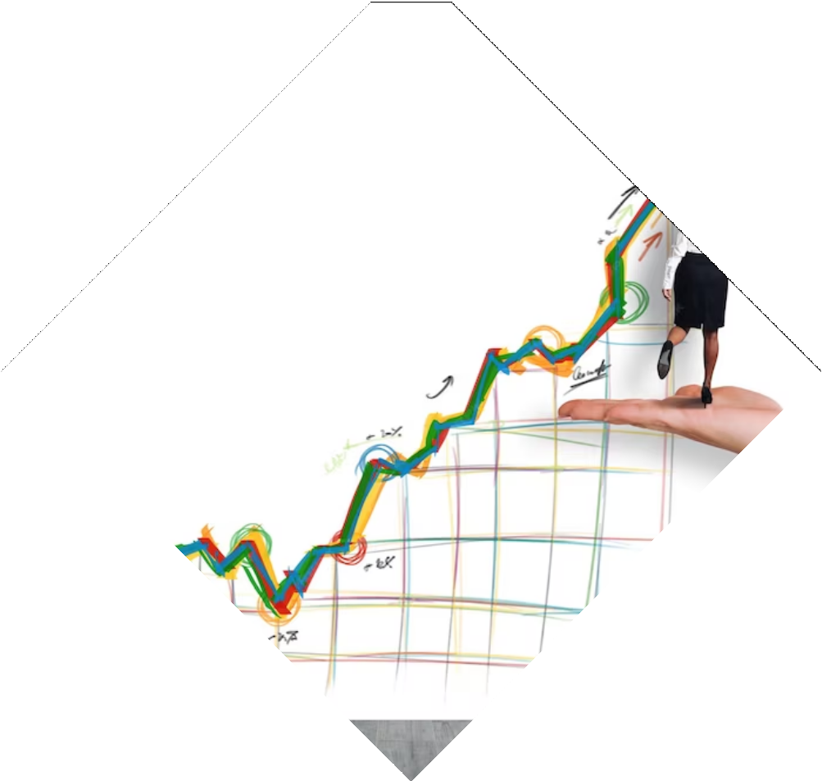
Introduction
Overview of the National Stock Exchange:
The National Stock Exchange (NSE) stands as the core of India's financial hub, and in its vast array of stocks, we concentrate on the Nifty 50 data. Our goal is forecasting stock prices through diverse modeling approaches. Leveraging econometric methods like ARIMA, statistical models such as KNN, and deep learning techniques like LSTM, we aim to capture complex patterns and trends. As we progress, our path includes the integration of Holt's Linear Trend, Holt-Winters Exponential Smoothing, and CNN methods, enhancing our predictive capabilities in the dynamic realm of stock price forecasting.

Slide 4
Objective of Time Series Forecasting in Stock Price Prediction
Time series forecasting plays a pivotal role in anticipating stock price movements, enabling stakeholders to make well-informed decisions. Understanding how these stocks are likely to perform is not only essential for investors but also for the broader financial ecosystem. Our project aims to harness the power of time series forecasting to provide valuable insights into the future of stocks spanning five diverse sectors.

Slide 5
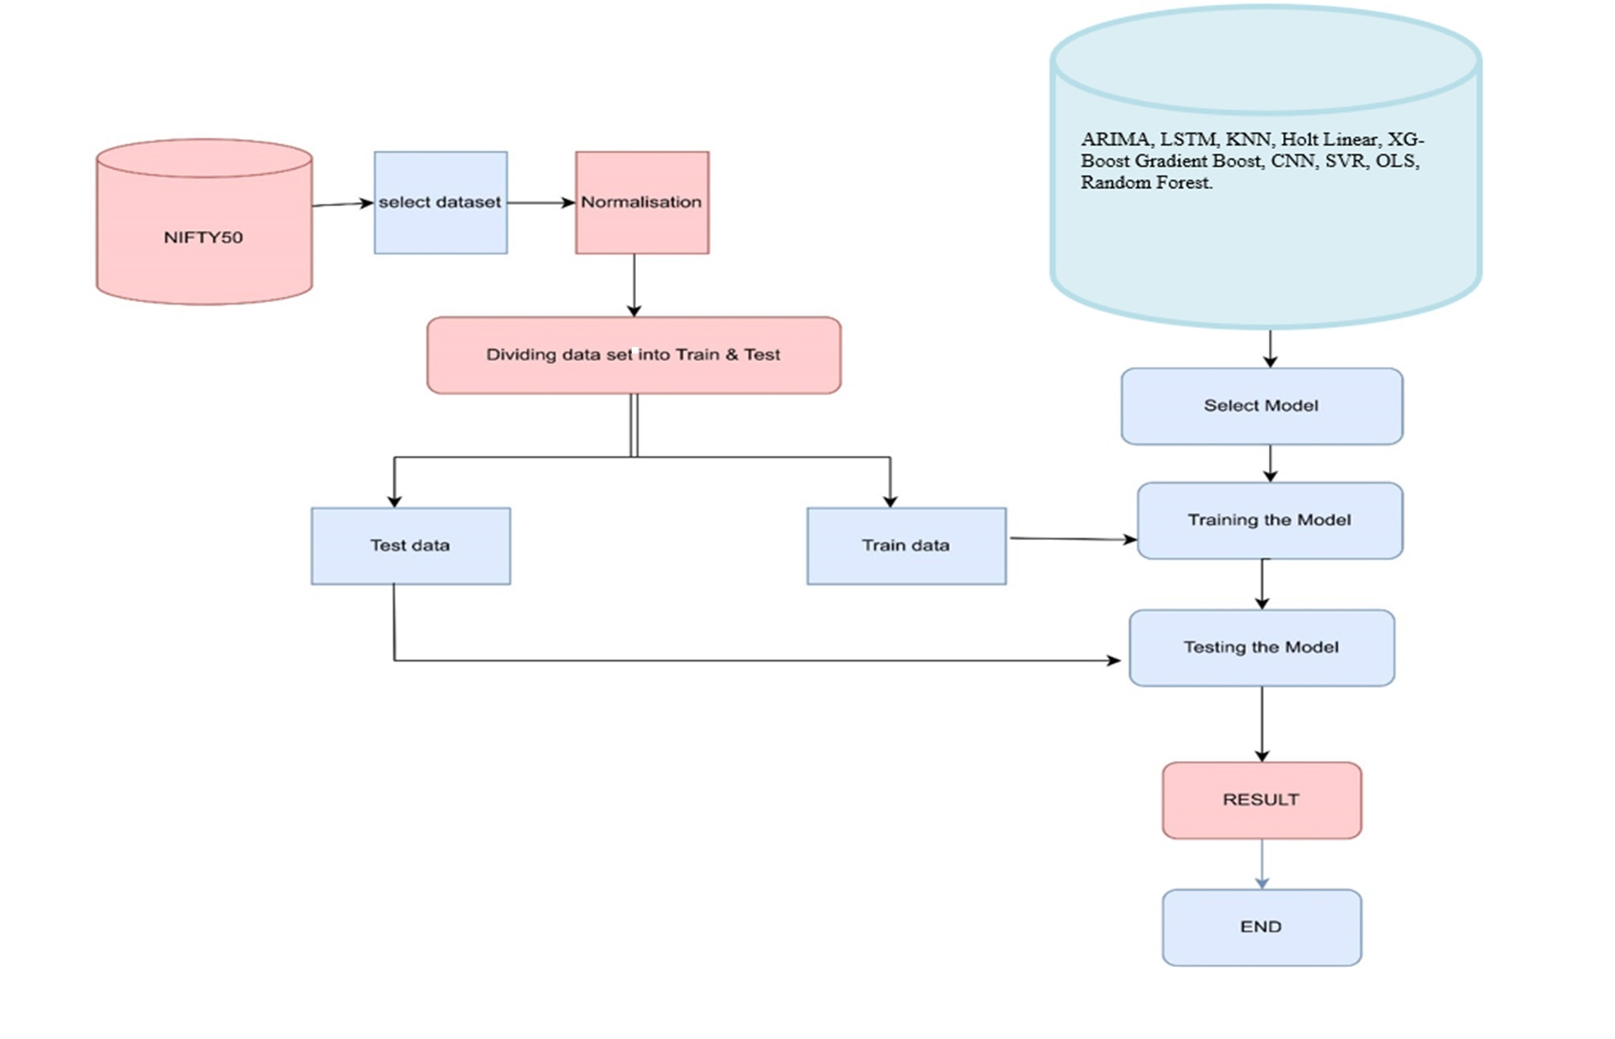
PROPOSED Methodology

Slide 6

Selected Base Paper
. Comprehensive Prediction of Stock Prices Using Time Series, Statistical, Machine Learning, and Deep Learning Models by Abhishek Jumar Aji Thomas, Nishant Kumar Todi, Olive Olemmyan, Swapnil Tripathi, Vaibhav Arora.
. Predictive Efficiency of ARIMA and ANN Models: A Case Analysis of Nifty-Fifty in Indian Stock Market by Vijay Shankar Pandey, Abhishek Bajpai.
Dataset Used
The dataset spans January 2017 to September 2023, comprising 2246 records of NIFTY50 index data, including opening, closing, highest, and lowest prices . Split into training (2017-2023) and testing (September2023-April 2024) sets, with 185 records for testing, it enables evaluating model performance on unseen data.
Algorithm Used
LSTM, ARIMA, KNN, Holt's Linear Trend, XG Boost ,Grad Boost, SVR,OLS, Random Forest & CNN

Slide 7

Implementation details
Implementation Details:
LSTM: Utilized Pandas for data loading, MinMaxScaler for normalization, TensorFlow/Keras for LSTM model building, and visualization via Matplotlib.
ARIMA: Imported Pandas for data handling, Statsmodels for ARIMA modeling, and Matplotlib for visualizations.
KNN: Applied Pandas for data manipulation, MinMaxScaler for data scaling, and Sklearn for KNN modeling and evaluation.
CNN (Convolutional Neural Network): Utilized Pandas for data loading, TensorFlow/Keras for CNN model construction, and Matplotlib for visualizations of model performance.

Slide 8

Holt's Linear Trend: Employed Pandas for data loading and manipulation, used Statsmodels for Holt's Linear Trend modeling, and Matplotlib for visualization
XG Boost: Utilized Pandas for data handling, employed XGBoost library for model building, and Matplotlib for the plotting of results.
Gradient Boosting: Employed Pandas for data manipulation, utilized Scikit-learn or XG Boost library for gradient boosting model construction, and Matplotlib for visualizations.
SVR (Support Vector Regression): Utilized Pandas for data manipulation, applied Scikit-learn for SVR model building, and Matplotlib for visualization.
OLS (Ordinary Least Squares): Employed Pandas for data handling, utilized Stats-models for OLS regression modeling, and Matplotlib for visualization.
Random Forest: Employed Pandas for data manipulation, utilized Scikit-learn for Random Forest model construction, and Matplotlib for visualizations.

Slide 9
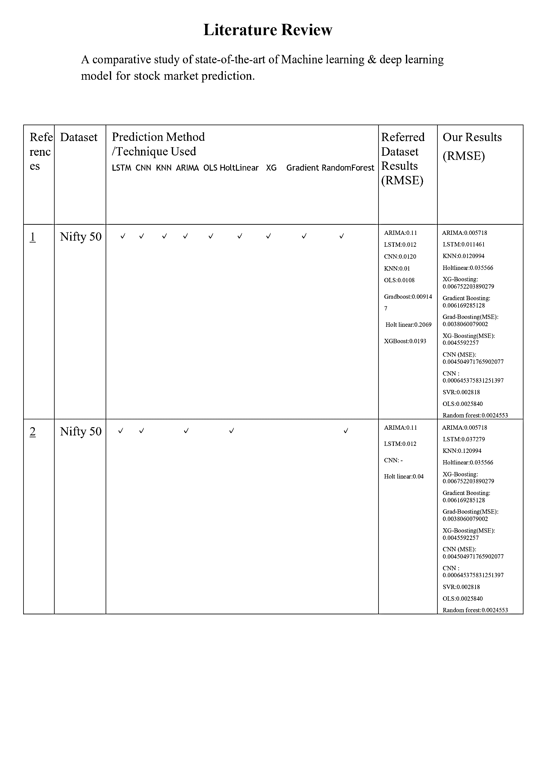
Comparative study of Results

Slide 10
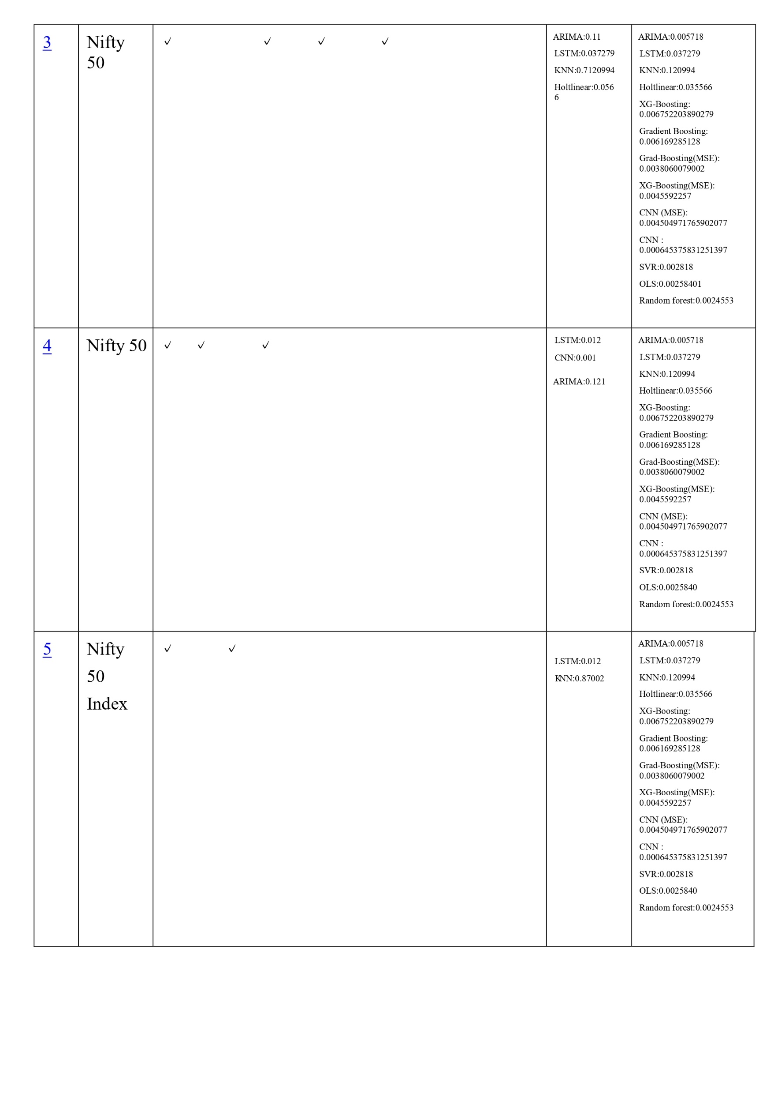
5 | Nifty 50 Index | ✓ ✓ | LSTM:0.012 RNN:0.002 | ARIMA:0.005718 LSTM:0.037279 KNN:0.120994
6 | Nifty50 | ✓ | LSTM:0.001 2 | ARIMA:0.005718 LSTM:0.037279 KNN:0.120994
7 | Nifty 50 Index | ✓ | LSTM:0.010 2 | ARIMA:0.005718 LSTM:0.037279 KNN:0.120994
8 | Nifty 50 Index | ✓ ✓ | LSTM:0.012 CNN: - | ARIMA:0.005718 LSTM:0.037279 KNN:0.120994
9 | Nifty IT | ✓ ✓ | LSTM:0.031 RNN: 0.004 | ARIMA:0.005718 LSTM:0.037279 KNN:0.120994
10 | Nifty 50 Index | ✓ ✓ | LSTM:0.012 RNN: 0.011 | ARIMA:0.005718 LSTM:0.037279 KNN:0.120994

Slide 11
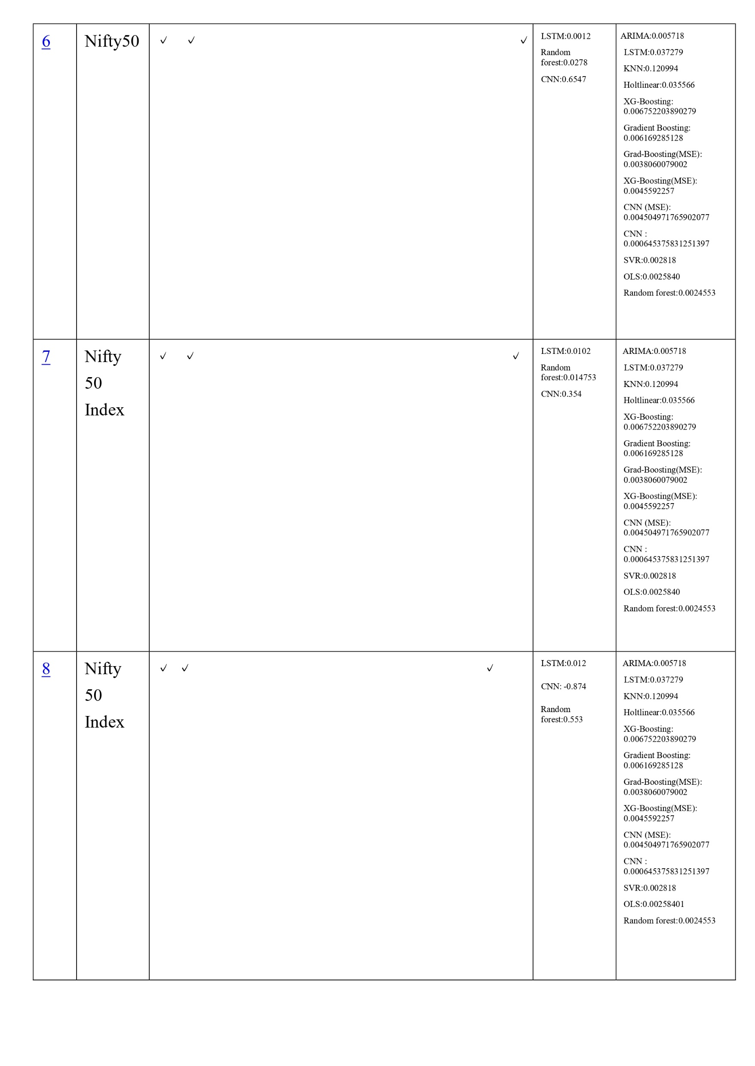

Slide 12
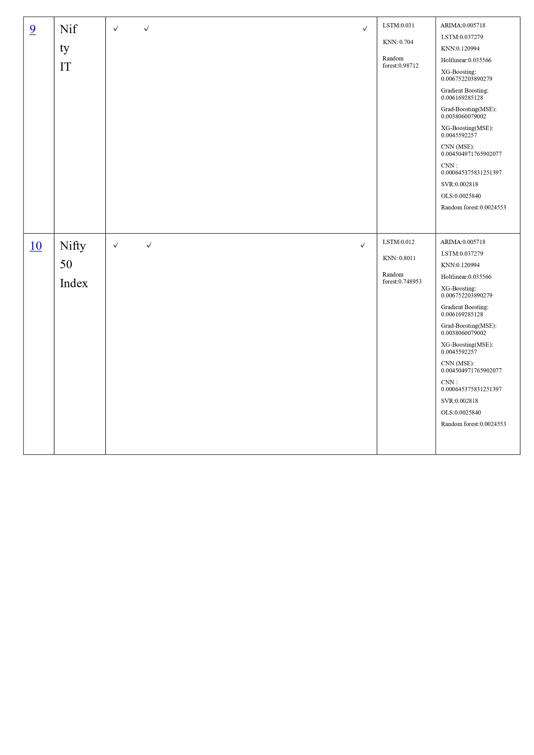

Slide 13
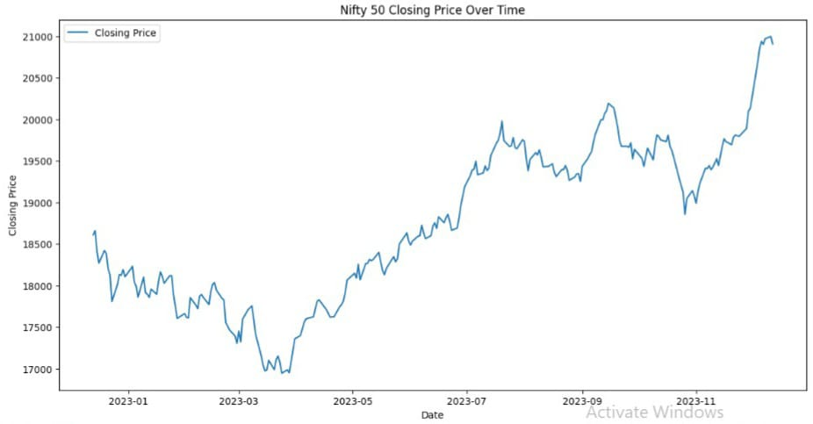
Results

Slide 14
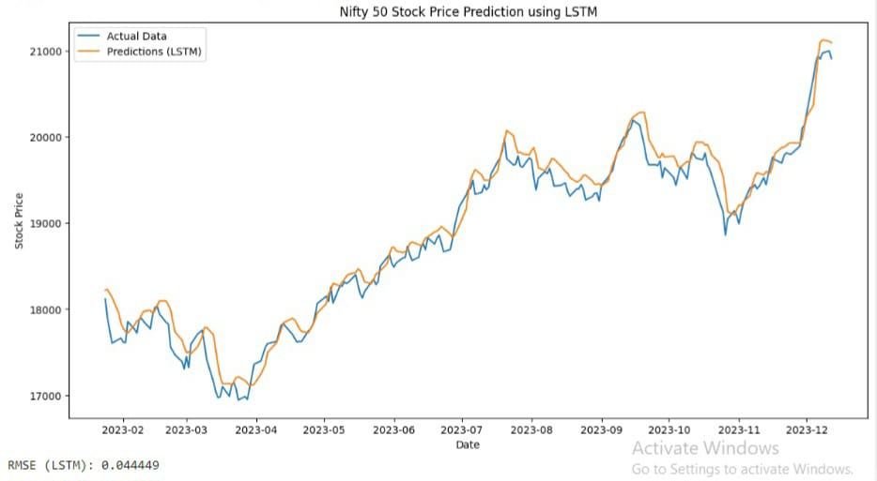

Slide 15
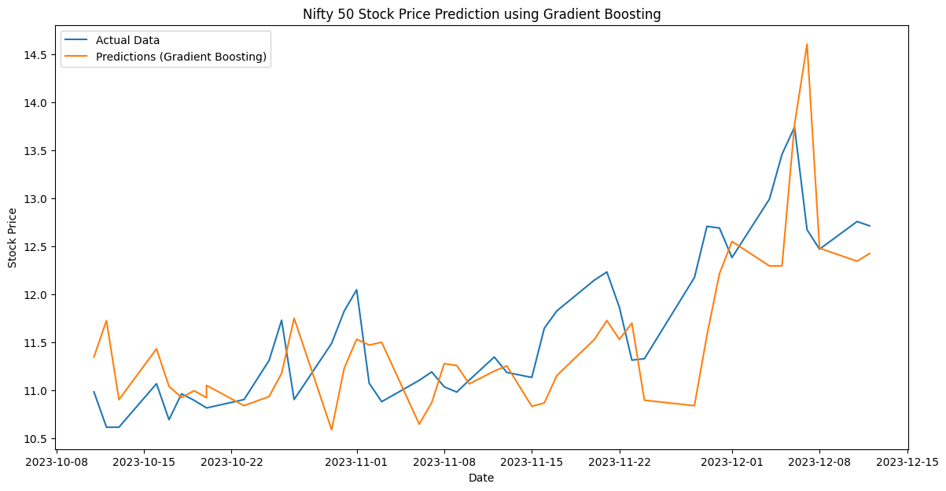

Slide 16
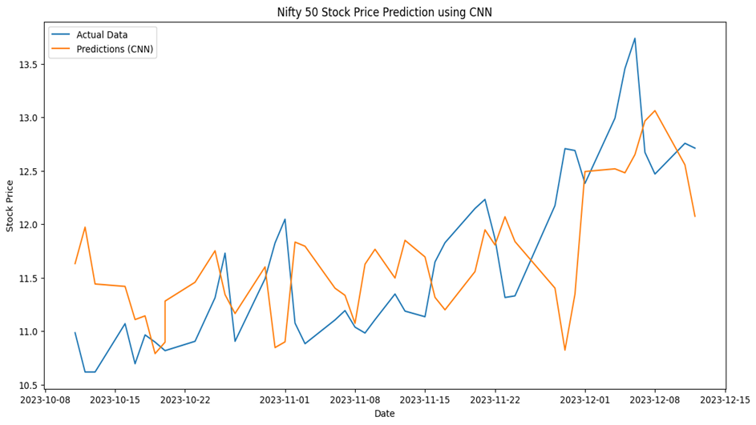

Slide 17
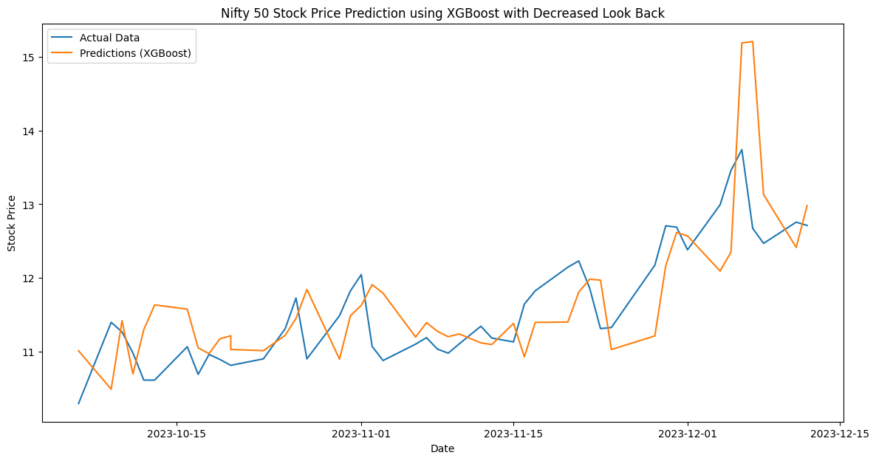

Slide 18
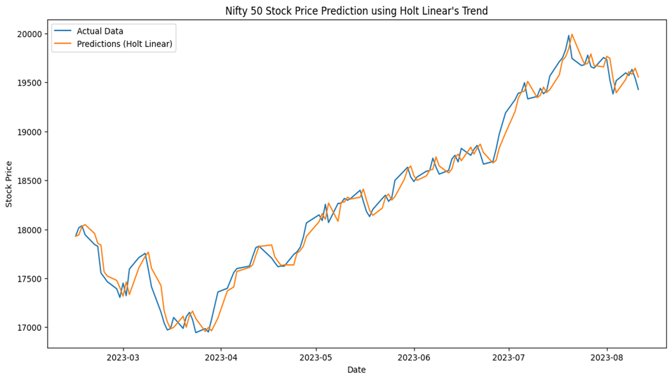

Slide 19
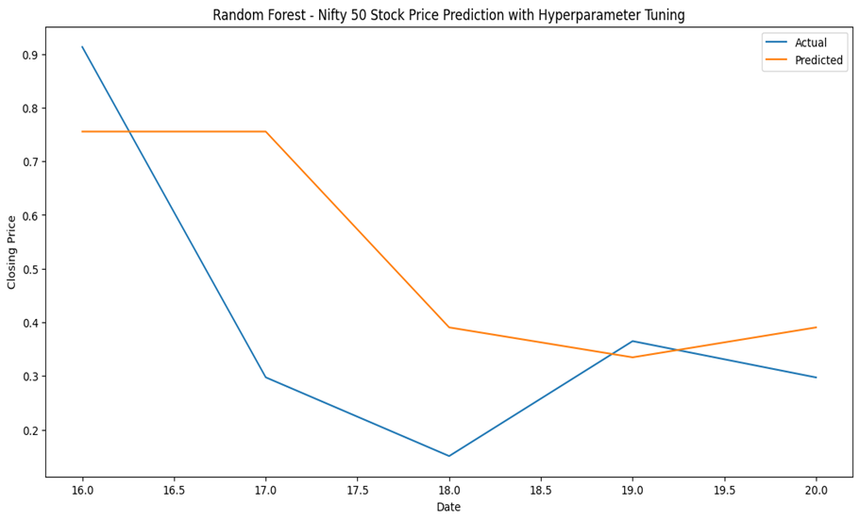

Slide 20
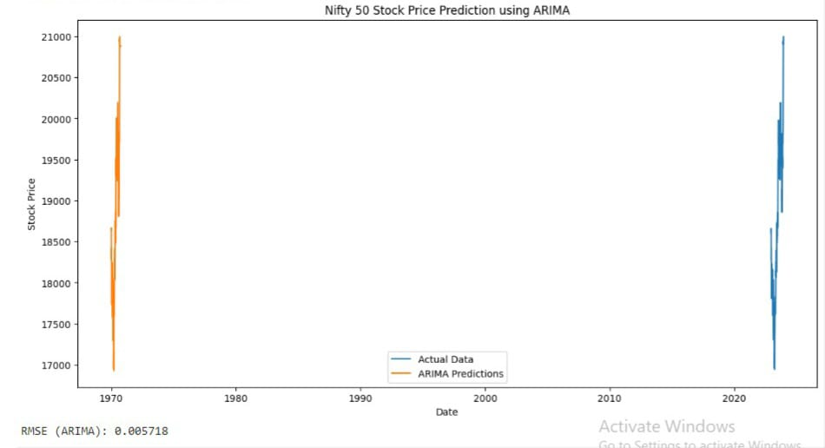

Slide 21
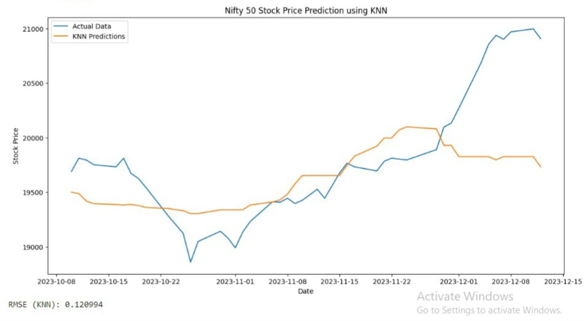

Slide 22
Discussion of findings
In our evaluation of forecasting models, we determined
the Mean Squared Error (MSE) for each approach, with
the following results:- ARIMA:0.005718
LSTM:0.011461
KNN:0.0120994
Holtlinear:0.035566
XG-Boosting: 0.006752203890279
Gradient Boosting: 0.006169285128
Grad-Boosting(MSE): 0.0038060079002
XG-Boosting(MSE): 0.0045592257
CNN (MSE): 0.004504971765902077
CNN : 0.000645375831251397
SVR:0.002818
OLS:0.0025840
Random forest:0.0024553

Slide 23
References
1) Comprehensive Stock Price Prediction Framework Using Time Series, Econometric, Statistics, Machine Learning, and Deep Learning Models Thesis · May 2023 DOI: 10.13140/RG.2.2.32783.76965/
2) Zahra Fathali, Zahra Kodia & Lamjed Ben Said (2022) Stock Market Prediction of NIFTY 50 Index Applying Machine Learning Techniques, Applied Artificial Intelligence, 36:1, 2111134, DOI: 10.1080/08839514.2022.2111134
3) Stock Market Forecasting Technique using Arima Model Bijesh Dhyani, Manish Kumar, Poonam Verma, Abhisheik Jain, DOI:10.35940/ijrte.F8405.038620
4) Zaheer, S.; Anjum, N.; Hussain, S.; Algarni, A.D.; Iqbal, J.; Bourouis, S.; Ullah, S.S. A Multi Parameter Forecasting for Stock Time Series Data Using LSTM and Deep Learning Model. Mathematics 2023, 11, 590. https://doi.org/10.3390/math11030590

Slide 24
Thankyou!

